Slide 1
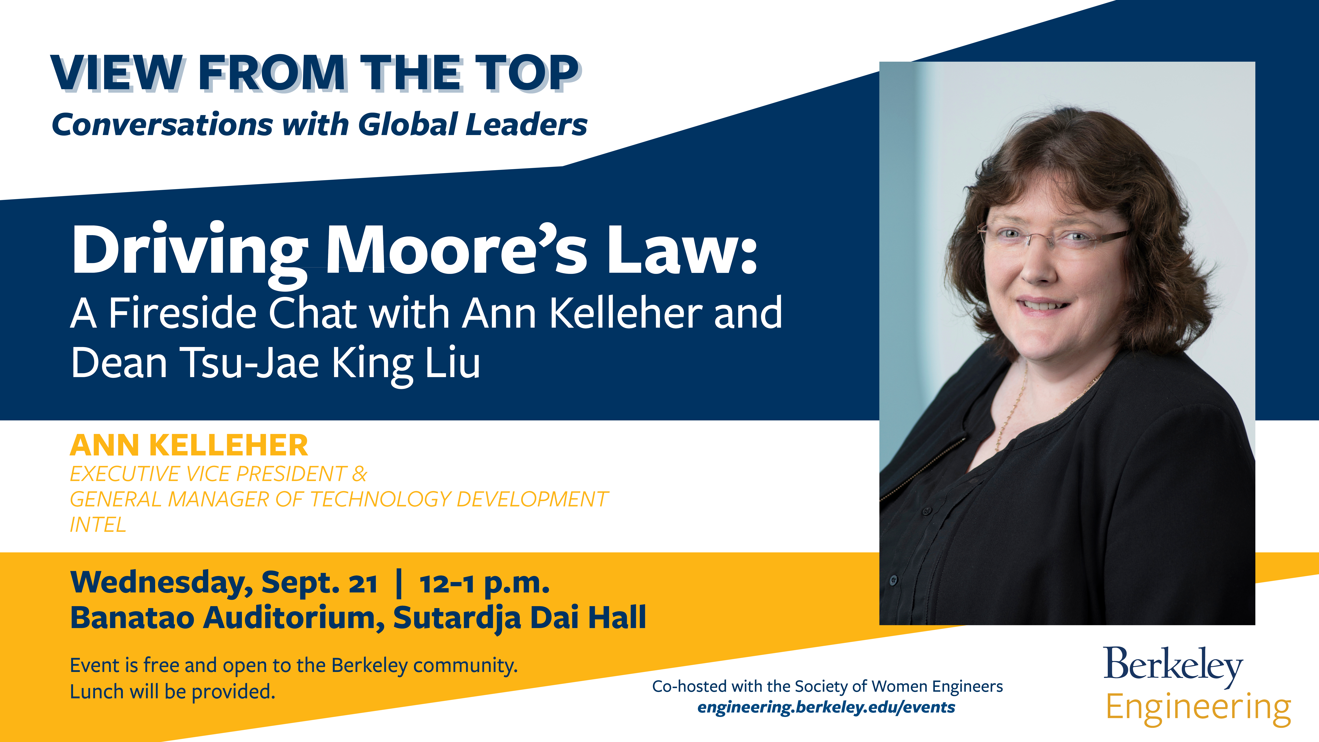

Slide 2
New AI tools that can write student essays require educators to rethink teaching and assessment
The entire “student essay” was written by a Transformer AI program, GPT-3. I gave it the prompt “The construct of ‘learning styles’ is problematic because” and it produced the rest, including headings and references. Plagiarism software will not detect essays written by Transformers, because the text is generated, not copied. A Google search of the essay shows that each sentence is original.
Note its reference for “Dunn and Dunn (1997)”. There is a journal of Research in Education, but no issue 7(2) in 1997. Dunn and Dunn did publish on learning styles, but not in that journal. GPT-3 has fashioned a plausible-looking but fake reference. It has also invented a fictitious research study from Dunn and Dunn to critique learning styles. Just as a student can generate an essay in seconds, so a teacher can assess it. Add “Here is a short assessment of this student essay:” to the end of the text and GPT-3 writes a review.
The essay discusses the idea of learning styles, and how they may be developed over time. It cites research by Dunn and Dunn which suggests that learning styles are not fixed, and that people can learn in different ways depending on the situation. The essay is well-organized and flows smoothly. It makes a clear argument and supports it with evidence from research. One potential criticism is that the essay does not discuss the implications of learning styles research, or how this research can be used to improve learning. However, this is not necessarily a flaw, as the essay is only meant to be a brief overview of the topic.
Learning Styles
The construct of “learning styles” is problematic because it fails to account for the processes through which learning styles are shaped. Some students might develop a particular learning style because they have had particular experiences. Others might develop a particular learning style by trying to accommodate to a learning environment that was not well suited to their learning needs. Ultimately, we need to understand the interactions among learning styles and environmental and personal factors, and how these shape how we learn and the kinds of learning we experience.
Learning styles and learning modes
In the 1970s, learning styles became an important feature of educational practice. In the 1990s, “learning modalities” became a major focus of learning style research. This is the idea that we process information in different ways. For example, some individuals may be auditory learners, benefiting from listening to lectures and using recorded materials. Others may be visual learners, who gain from using visual materials such as textbooks, handouts, and computer graphics. Still others may be kinesthetic learners, who benefit from learning by movement and doing. Numerous experiments have been conducted to test this idea, and a number of different classifications of learning modalities have been proposed.
In a review of this research, Dunn and Dunn (1997) found that the evidence does not support the idea that people have a particular learning mode that is dominant or that they process information in a particular way. In their study, the authors found that when students were given a particular instructional treatment, they could be classified in a particular learning modality category. But when they were given a different instructional treatment, they were classified in a different category. In a follow-up study in which they gave students a number of instructional treatments, Dunn and Dunn found that students could be placed in a particular category in some treatments, but not others.
Dunn and Dunn also found that the results varied by age. Older students generally fit the results of more than one modality, whereas younger students were more likely to fit the results of just one modality. This led them to conclude that style preferences are learned over the course of development. This is consistent with the idea that people are flexible in responding to the way they are taught.
References
Dunn, R., & Dunn, K. (1997). Learning styles: Research and practice. Journal of Research in Education, 7(2), 139-151.
blogs.lse.ac.uk/impactofsocialsciences/2022/05/17/new-ai-tools-that-can-write-student-essays-require-educators-to-rethink-teaching-and-assessment/

Slide 3
RISC-V Procedures

Slide 4
C Functions
main() { int i,j,k,m; ... i = mult(j,k); ... m = mult(i,i); ...
}
/* really dumb mult function */
int mult (int mcand, int mlier){ int product = 0; while (mlier > 0) { product = product + mcand; mlier = mlier -1; } return product;
}
What information must compiler/programmer keep track of?
What instructions can
accomplish this?

Slide 5
Six Fundamental Steps in Calling a Function
Put arguments in a place where function can access them
Transfer control to function
Acquire (local) storage resources needed for function
Perform desired task of the function
Put return value in a place where calling code can access it and restore any registers you used; release local storage
Return control to point of origin, since a function can be called from several points in a program

Slide 6
RISC-V Function Call Conventions
Registers faster than memory, so use them
a0–a7 (x10-x17): eight argument registers to pass parameters and two return values (a0-a1)
ra: one return address register to return to the point of origin (x1)
Also s0-s1 (x8-x9) and s2-s11 (x18-x27): saved registers (more about those later)
Notes:
$at – assembler temporary register, used for pseudo instructions

Slide 7
Instruction Support for Functions (1/4)
... sum(a,b);... /* a,b:s0,s1 */ } int sum(int x, int y) { return x+y; }
address (shown in decimal) 1000 1004 1008 1012 1016 … 2000 2004
C
In RISC-V, all instructions are 4 bytes, and stored in memory just like data. So, here we show the addresses of where the programs are stored.
RISC-V

Slide 8
Instruction Support for Functions (2/4)
... sum(a,b);... /* a,b:s0,s1 */ } int sum(int x, int y) { return x+y; }
address (shown in decimal) 1000 mv a0,s0 # x = a 1004 mv a1,s1 # y = b 1008 addi ra,zero,1016 #ra=1016 1012 j sum #jump to sum 1016 … # next inst.
… 2000 sum: add a0,a0,a1 2004 jr ra #new instr.“jump reg”
C
RISC-V

Slide 9
Instruction Support for Functions (3/4)
... sum(a,b);... /* a,b:s0,s1 */ } int sum(int x, int y) { return x+y; }
C
Question: Why use jr here? Why not use j?
Answer: sum might be called by many places, so we can’t return to a fixed place. The calling proc to sum must be able to say “return here” somehow.
RISC-V
… 2000 sum: add a0,a0,a1 2004 jr ra #new instr.“jump reg”

Slide 10
Instruction Support for Functions (4/4)
Single instruction to jump and save return address: jump and link (jal)
Before: 1008 addi ra,zero,1016 # ra=1016 1012 j sum # goto sum
After: 1008 jal sum # ra=1012,goto sums
Why have a jal?
Make the common case fast: function calls very common
Reduce program size
Don’t have to know where code is in memory with jal!

Slide 11
RISC-V Function Call Instructions
Invoke function: jump and link instruction (jal)
(really should be laj “link and jump”)
“link” means form an address or link that points to calling site to allow function to return to proper address
Jumps to address and simultaneously saves the address of the following instruction in register ra
jal FunctionLabel
Return from function: jump register instruction (jr)
Unconditional jump to address specified in register: jr ra
Assembler shorthand: ret = jr ra

Slide 12
Summary of Instruction Support
Actually, only two instructions:
jal rd, Label – jump-and-link
jalr rd, rs, imm – jump-and-link register
As we’re going to see, ”ain’t no free lunch”, so there might not be enough bits left for the Label to go as far as we want to jump.
With jalr, we jump to the contents of the register rs + immediate imm (like a base pointer and offset) and set rd as in jal
j, jr and ret are pseudoinstructions!
j: jal x0, Label

Slide 13
Where Are Old Register Values Saved to Restore Them After Function Call?
Need a place to save old values before calling function, restore them when return, and delete
Ideal is stack: last-in-first-out (LIFO) queue (e.g., stack of plates)
Push: placing data onto stack
Pop: removing data from stack
Stack in memory, so need register to point to it
sp is the stack pointer in RISC-V (x2)
Convention is grow stack down from high to low addresses
Push decrements sp, Pop increments sp

Slide 14
Stack
Stack frame includes:
Return “instruction” address
Parameters (arguments)
Space for other local variables
Stack frames contiguous blocks of memory; stack pointer tells where bottom of stack frame is
When procedure ends, stack frame is tossed off the stack; frees memory for future stack frames
0xFFFFFFF0
frame
frame
frame
frame
$sp

Slide 15
RISC-V
Function Call Example

Slide 16
Function Call Example
int Leaf (int g, int h, int i, int j)
{
int f;
f = (g + h) – (i + j);
return f;
}
Parameter variables g, h, i, and j in argument registers a0, a1, a2, and a3, and f in s0
Assume need one temporary register s1

Slide 17
RISC-V Code for Leaf()
Leaf: addi sp,sp,-8 # adjust stack for 2 items
sw s1, 4(sp) # save s1 for use afterwards
sw s0, 0(sp) # save s0 for use afterwards
add s0,a0,a1 # f = g + h
add s1,a2,a3 # s1 = i + j
sub a0,s0,s1 # return value (g + h) – (i + j)
lw s0, 0(sp) # restore register s0 for caller
lw s1, 4(sp) # restore register s1 for caller
addi sp,sp,8 # adjust stack to delete 2 items
jr ra # jump back to calling routine
int Leaf ( int g, int h, int i, int j)
{
int f;
f = (g + h) – (i + j);
return f;
}

Slide 18
Stack Before, During, After Function
Need to save old values of s0 and s1
sp
sp
Saved s1
Saved s1
sp
Saved s0
Saved s0
Before call
During call
After call

Slide 19
Nested Calls and Register Conventions

Slide 20
What If a Function Calls a Function? Recursive Function Calls?
Would clobber values in a0-a7 and ra
What is the solution?
Notes:
Save $ra on the stack

Slide 21
Nested Procedures
int sumSquare(int x, int y) { return mult(x,x)+ y; }
Something called sumSquare, now sumSquare is calling mult
So there’s a value in ra that sumSquare wants to jump back to, but this will be overwritten by the call to mult
Need to save sumSquare return address before call to mult – again, use stack

Slide 22
Register Conventions (1/2)
CalleR: the calling function
CalleE: the function being called
When callee returns from executing, the caller needs to know which registers may have changed and which are guaranteed to be unchanged.
Register Conventions: A set of generally accepted rules as to which registers will be unchanged after a procedure call (jal) and which may be changed.

Slide 23
Register Conventions (2/2)
To reduce expensive loads and stores from spilling and restoring registers, RISC-V function-calling convention divides registers into two categories:
Preserved across function call
Caller can rely on values being unchanged
sp, gp, tp, “saved registers” s0- s11 (s0 is also fp)
Not preserved across function call
Caller cannot rely on values being unchanged
Argument/return registers a0-a7,ra, “temporary registers” t0-t6

Slide 24
RISC-V Symbolic Register Names
Numbers hardware understands
Register | ABI Name | Description | Saver
x0 | zero | Hard-wired zero | -
x1 | ra | Return address | Caller
x2 | sp | Stack pointer | Callee
x3 | gp | Global pointer | -
x4 | tp | Thread pointer | -
x5 | t0 | Temporary/Alternate link register | Caller
x6-7 | t1-2 | Temporaries | Caller
x8 | s0/fp | Saved register/Frame pointer | Callee
x9 | s1 | Saved register | Callee
x10-11 | a0-1 | Function arguments/Return values | Caller
x12-17 | a2-7 | Function arguments | Caller
x18-27 | s2-11 | Saved registers | Callee
x28-31 | t3-6 | Temporaries | Caller
Human-friendly symbolic names in assembly code

Slide 25
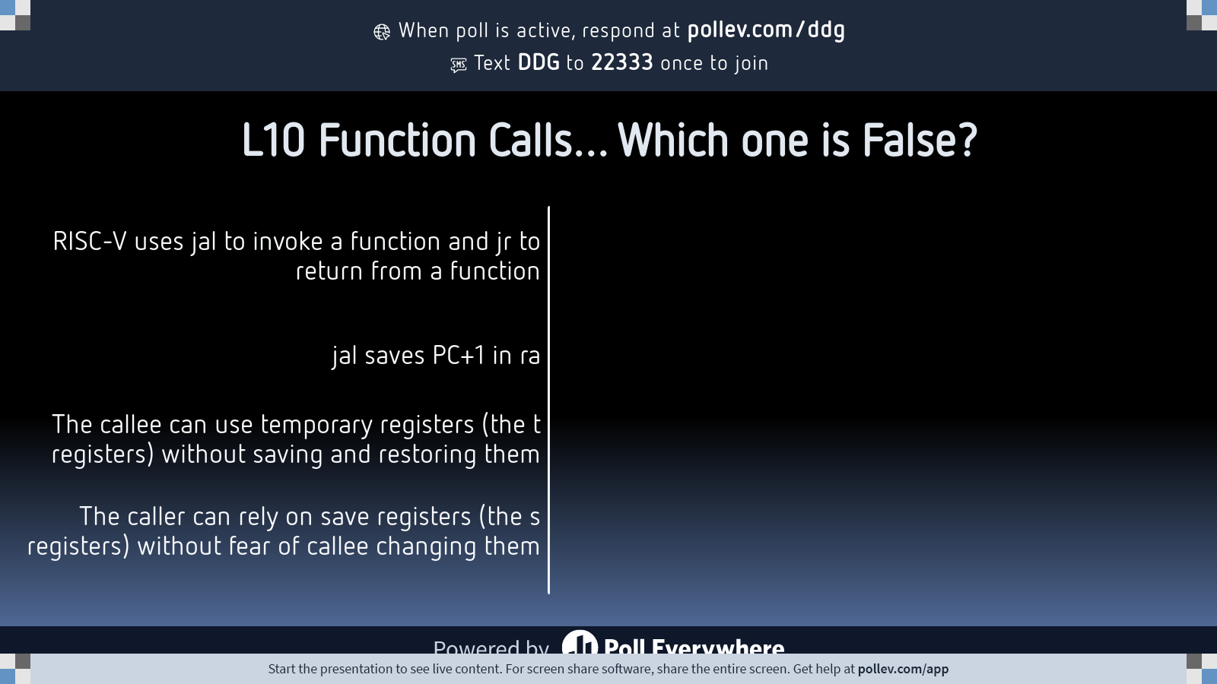
Notes:
Do not modify the notes in this section to avoid tampering with the Poll Everywhere activity. More info at polleverywhere.com/support L10 Function Calls… Which one is False?
https://www.polleverywhere.com/multiple_choice_polls/tYPQU8gcUkir0Aslx441l?state=opened&flow=Default&onscreen=persist

Slide 26
And in Conclusion, the RV32 So Far…
(Watch 12m bonus video on Memory Allocation!)
https://drive.google.com/file/d/1MR32HeTNj1phgeR5cVRmhx-GUrHBtcEb/view?usp=sharing
Arithmetic/logic
add rd, rs1, rs2
sub rd, rs1, rs2
and rd, rs1, rs2
or rd, rs1, rs2
xor rd, rs1, rs2
sll rd, rs1, rs2
srl rd, rs1, rs2
sra rd, rs1, rs2
Immediate
addi rd, rs1, imm
subi rd, rs1, imm
andi rd, rs1, imm
ori rd, rs1, imm
xori rd, rs1, imm
slli rd, rs1, imm
srli rd, rs1, imm
srai rd, rs1, imm
Load/store
lw rd, rs1, imm
lb rd, rs1, imm
lbu rd, rs1, imm
sw rs1, rs2, imm
sb rs1, rs2, imm
Branching/jumps
beq rs1, rs2, Label
bne rs1, rs2, Label bge rs1, rs2, Label blt rs1, rs2, Label bgeu rs1, rs2, Label bltu rs1, rs2, Label jal rd, Label jalr rd, rs, imm
Notes:
Each kernel has a register footprint
And note that register use can be optimized better than I did before

